Slide 1


Data Mining Applications: Motor Vehicle Crash Database
Group 8
Presented by:
Jayesh Patil
Subash Chakravarthy
Yuchen He

Slide 2

Introduction
Employed rigorous data cleaning and outlier removal techniques, utilizing Python for exploratory visualizations.
Identified three key patterns that informed further analysis and decision-making.
Combined supervised and unsupervised learning methods:
Used support vector machines for initial feasibility assessment.
Achieved 94% accuracy with gradient-boosting ensembles (CatBoost & LightGBM).
Implemented K-means clustering to identify hidden crash types.
Utilized principal-component analysis for dimensional reduction.
Applied Apriori rule mining to discover actionable insights.
Each method chosen for its specific advantages in interpretability and performance related to transportation data

Slide 3

Motor Vehicle Crash Database
Data Sources
Key Variables
Rationale:
Analyzed 195,092 crash reports from the state's Crash Reporting database to identify patterns and improve road safety.
Accident time and location
Rich in both categorical and numeric features—ideal for machine learning exploration.
Weather and road conditions
Vehicle type and driver info
Crash severity

Slide 4


Core Business Questions
Q. Can we accurately predict whether a crash will result in an injury based on environmental conditions, vehicle details, and driver behavior?
Q. How can we segment vehicle-involved crashes into distinct clusters based on driving conditions and vehicle characteristics to inform targeted road safety interventions?
Q. What are the key factors that influence injury severity in motor vehicle crashes?
Q. Can we accurately predict the injury severity category (e.g., No Injury, Minor Injury, Serious Injury, Fatal Injury) using available crash data?
Q. Can data balancing (e.g., SMOTE) and feature engineering techniques improve model performance for imbalanced classification tasks in traffic injury prediction?
Q. Who is likely to be at fault in a motor vehicle crash?
Q. What underlying structure or groupings exist among crash-related variables?
Q. What crash conditions tend to co-occur, revealing patterns in accidents?

Slide 5
Methodology
Step | Business Question (Simple Form) | Technique / Model | Why This Model? | Key Outcome
1 | Can we trust every row in this 195 k-record file? | IQR-based outlier removal & missing-value imputation | Crash data contains extreme speed limits and null vehicle years; a quick prune keeps later models honest. | 4 % of rows flagged; 3 % dropped, 1 % fixed.
2 | Is there even a learnable pattern here? | Support-Vector Machine (SVM) classifier | Fast to train; good at non-linear boundaries, perfect sanity check before heavier models. | 82 % accuracy, promising baseline.
3 | How precisely can we flag high-severity crashes before they occur? | CatBoost & LightGBM gradient-boosting | Excel with mixed numeric/categorical data and imbalance; CatBoost auto-encodes categories, LightGBM is lightning-fast. | CatBoost hit 94 % accuracy, ROC-AUC = 0.96.
4 | What does a naïve model say? | Gaussian Naïve Bayes | Provides a probabilistic benchmark in seconds; highlights lift gained by boosters. | 68 % accuracy confirms booster value.
5 | Do crashes naturally cluster into “archetypes” we can target? | K-means (k =3) | Simple, interpretable; elbow plot showed k = 3 optimal. | Three personas surfaced: Urban Rush, Night-time Weather, Rural Speeding.
6 | Can we see those clusters and major variance drivers? | Principal Component Analysis (PCA) | Reduces 39 variables to 2-3 axes with minimal info loss, ideal for plotting. | PC1 tied to speed & road type; PC2 to vehicle age & weather.
7 | What specific factor combos scream “danger”? | Apriori association-rule mining | Designed for categorical co-occurrence discovery; turns patterns into clear rules. | e.g., Wet surface + Night + Vehicle > 15 yrs ⇒ Injury severity ↑ 3× (support = 4 %, confidence = 62 %).

Slide 6
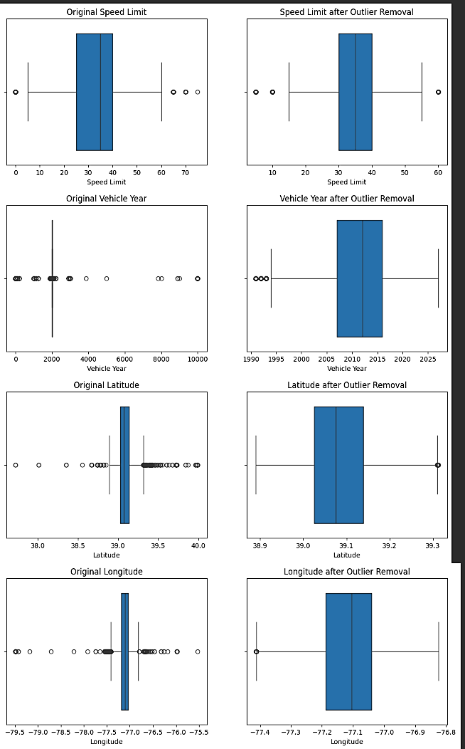
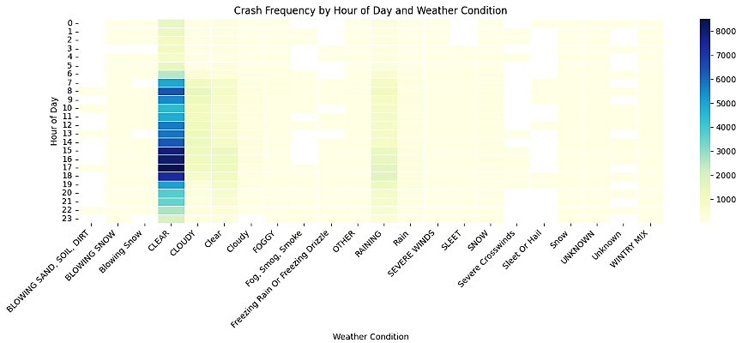
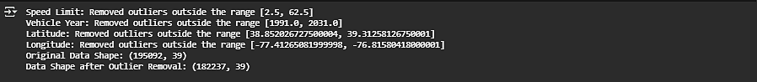
Exploratory Data Analysis
- Focused on removing outliers from the following key numeric columns: speed limit, vehicle year, latitude, and longitude.
- Cleaned dataset reduced from 195,092 to 182,237 records, enhancing analysis quality.
- Used boxplots to visually compare data before and after outlier removal.
- Boxplots illustrated the trimming of extreme values, resulting in cleaner, balanced data.
- Created a heatmap illustrating peak crash times based on the hour of the day and various weather conditions.
- Heatmap highlights that most crashes occur during daytime, particularly in clear weather, providing clear visibility of peak crash times and conditions.

Slide 7
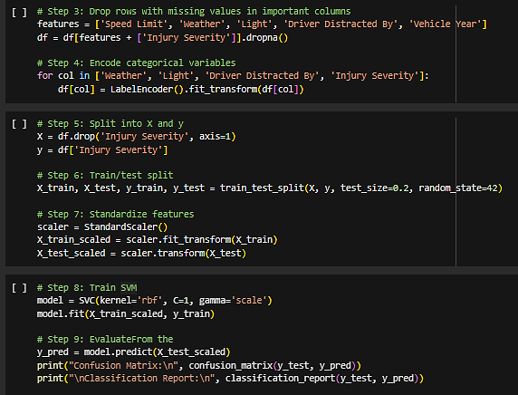


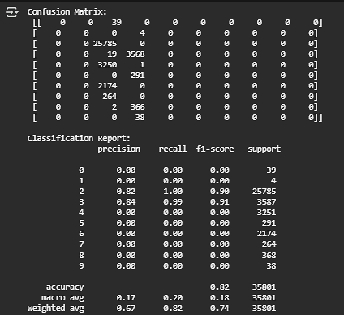

Model 1:Support Vector Machine (SVM)
Utilizes features like weather, vehicle year, driver distraction to predict crash outcomes.
Uses libraries like pandas, Seaborn, matplotlib, Scikit-learn
Steps include Data Cleaning, Label encoding , Data Splitting, Scaling, Model Training and Evaluation.
4
Achieved 82% accuracy in the confusion matrix and classification report.

Slide 8
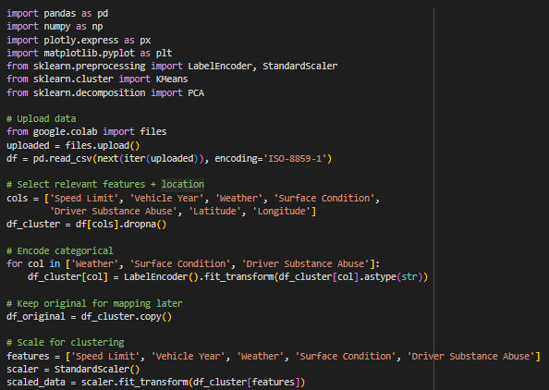
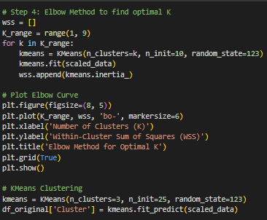
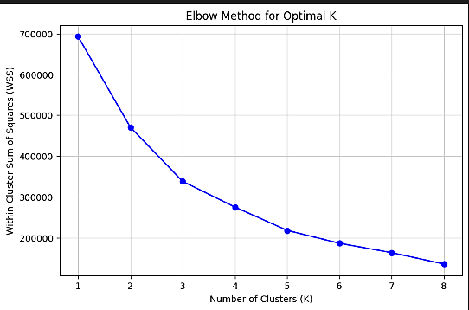
Model 2: K-means Clustering
ELBOW GRAPH
This section uses K-means clustering to group similar vehicle crash incidents based on factors like driving conditions, vehicle year, and substance abuse. Libraries used include pandas, numpy, scikit-learn, and matplotlib.
Select and encode features like weather, surface condition, and vehicle details.
Standardize the data to ensure fair clustering.
Use Elbow Method to find the optimal number of clusters (K), which appears to be around 3.

Slide 9
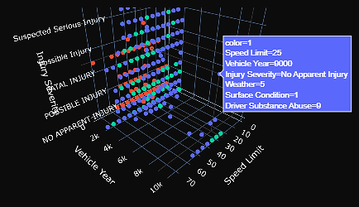
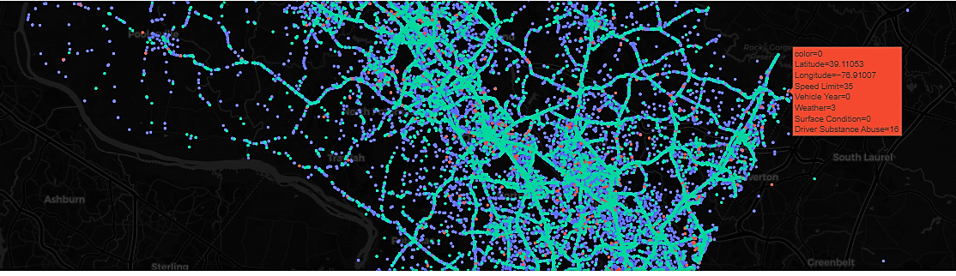
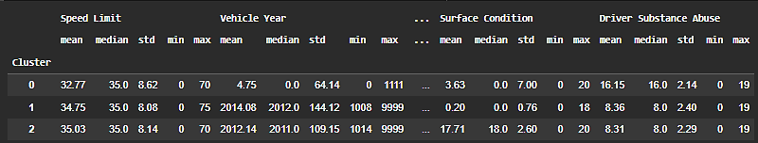
3 D Plot
Geo-cluster
Modeling
This step involves creating a 3D scatter plot to visualize the clustering of crash data based on factors like Speed Limit, Vehicle Year, and Injury Severity. In this visualization, blue dots represent crashes involving newer vehicles with no injuries, while red dots indicate older vehicles that are in worse conditions and associated with higher injury severity. This approach effectively highlights patterns across various crash types.
This section visualizes crash clusters on a map using latitude and longitude, helping us see where different types of crashes are concentrated geographically. The plot is created using Plotly’s mapbox with a dark-themed background for better contrast.
The features of three different crash groups that were found using K-means clustering are described in this summary. In metropolitan regions with lower speed limits and higher rates of substance addiction, Cluster 0 is characterized by older cars. Cluster 1 denotes slow zones, which are probably found in parking lots and have the lowest vehicle speeds and fewest hazards. On the other hand, Cluster 2, which is typical of highways, is made up of newer cars that drive faster and pose a moderate risk. A 3D plot and geo-map are included in the research to show differences in injury location and severity among

Slide 10
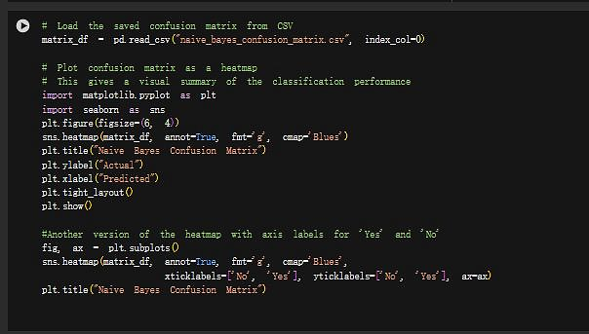
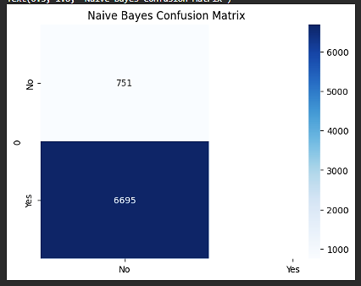
Model 3: Naïve Bayes Classification
“At Fault”: Precision = 0.86, Recall = 0.71
The heatmap of the confusion matrix showed that most misclassifications involved false negatives.
Confusion matrix showing Naïve Bayes model performance. The model tends to classify “Not At Fault” better than “At Fault.”

Slide 11
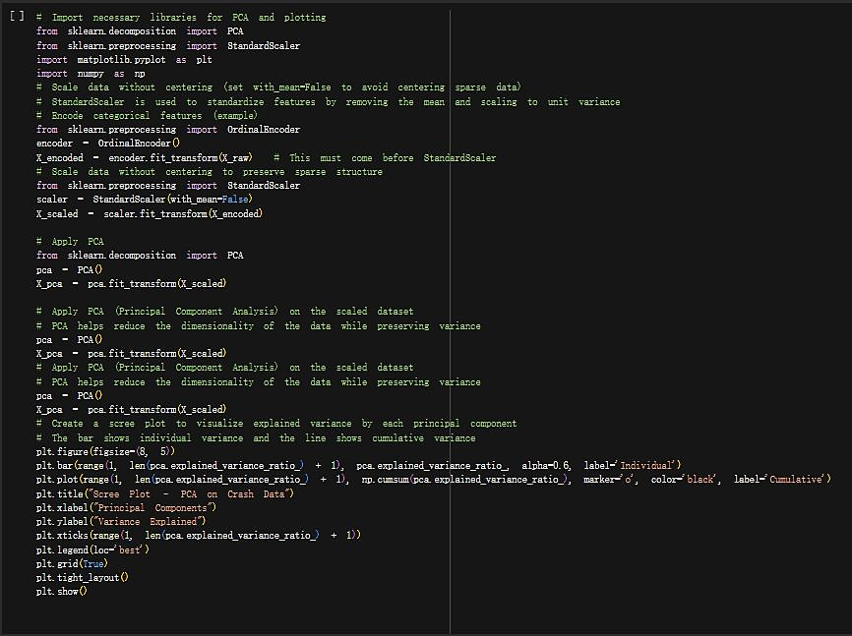
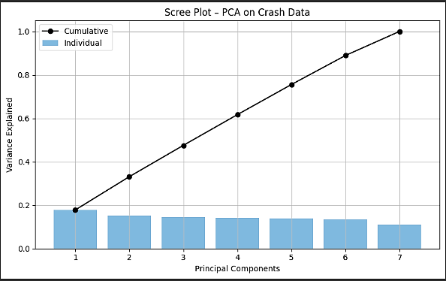
Model 4: Principal Component Analysis (PCA)
Performed on the encoded and scaled data.
First five components captured over 60% of the variance.
PC1: Strong loading from Speed Limit and Vehicle Year (an “old-and-fast” axis).
PC2: Patterns in Weather and Collision Type.Screen plot and loading matrix were generated to aid interpretation
PCA Findings
PC1 revealed a contrast between newer vehicles in slow zones vs. older in fast zones.
PC2 separated poor visibility from clear conditions.
Helped identify latent structure and reduce noise.

Slide 12
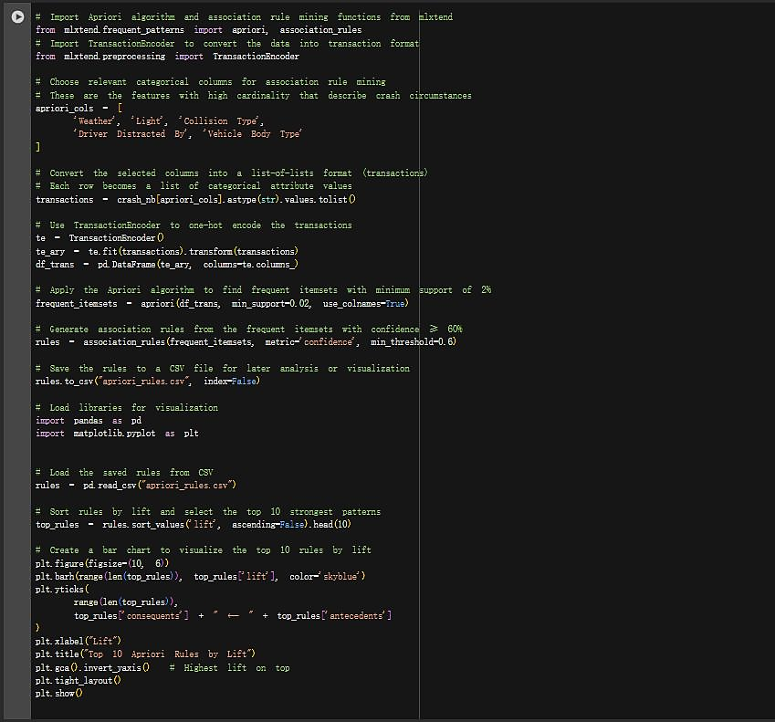
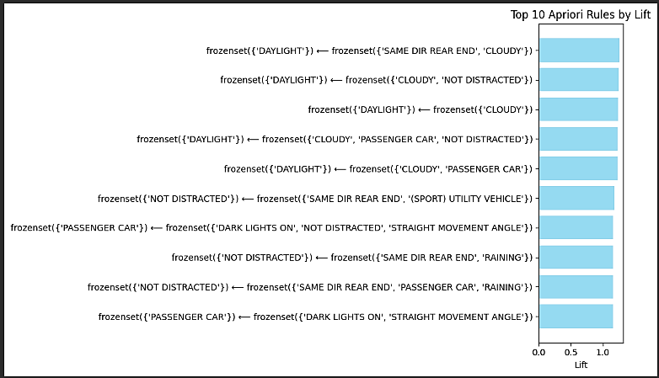
Model 5: Apriori Association Rule Mining
Apriori Association Rule Mining
Five categorical columns were converted into transactions.
Applied Apriori with 2% support and 60% confidence thresholds.
Rules were ranked by lift and saved to CSV.
Top rule: If Light = Dark (no street lights) and Weather = Clear, then Collision Type = Angle. (Support: 2.4%, Confidence: 61%, Lift: 2.1)
Top 10 Apriori rules ranked by Lift. Most rules connect lighting and distraction to crash types.
Visualization of top 10 rules by lift was created using matplotlib.

Slide 13
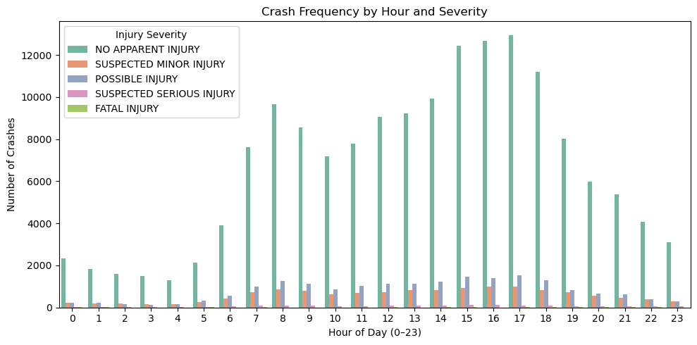
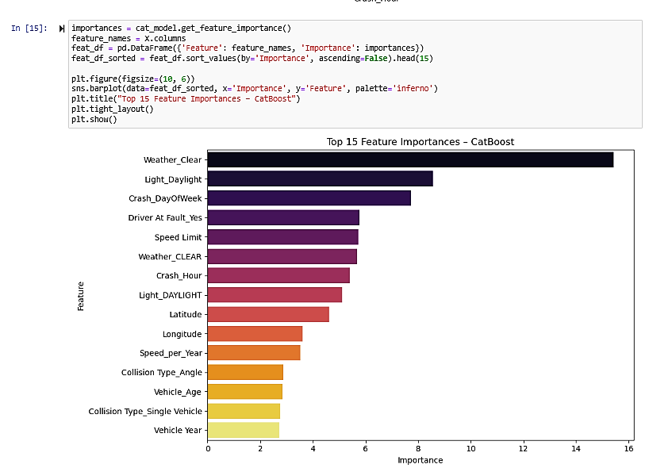
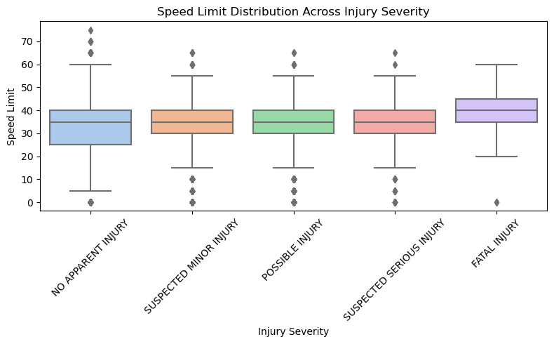
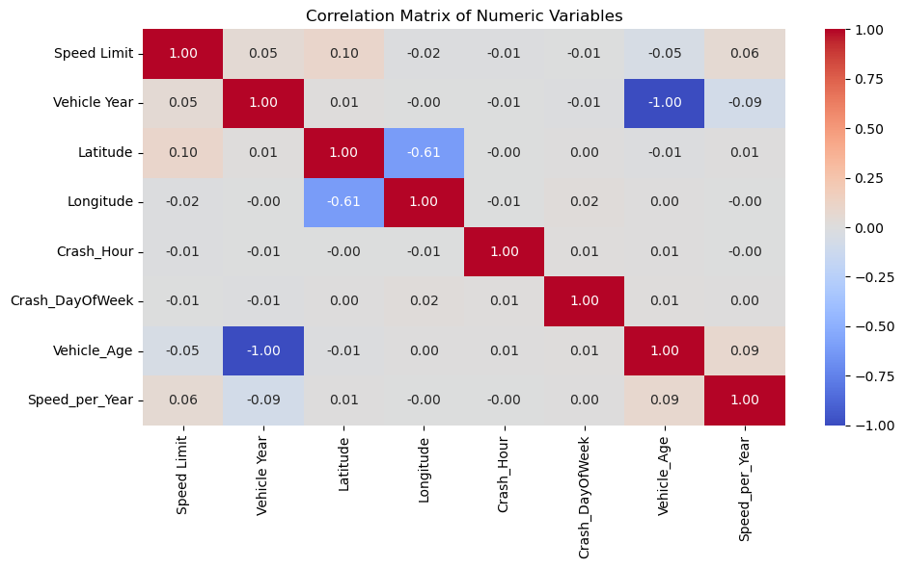
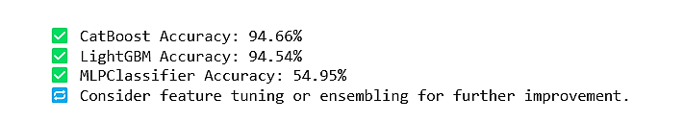
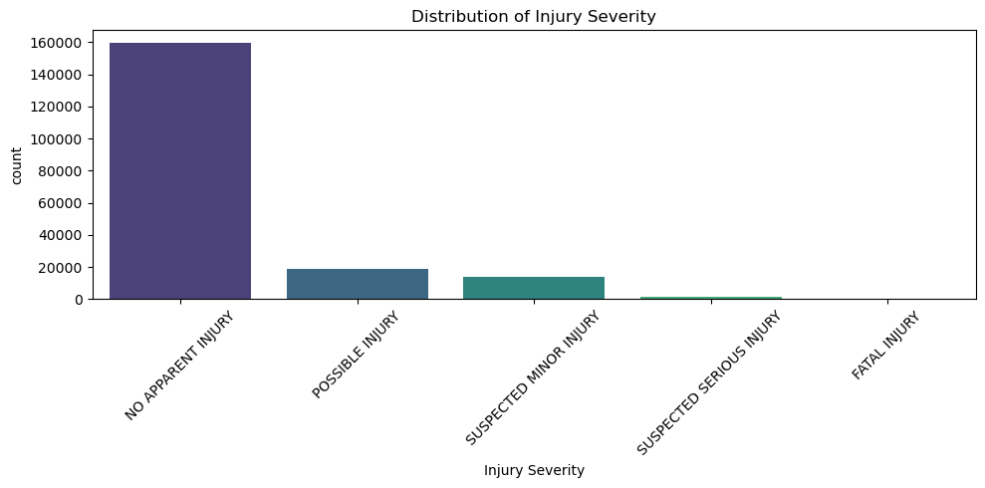
Model 6:CatBoost, LightGBM and MLP Classifier
Due to feature scaling and complicated data structures, MLPClassifier performs badly, whereas CatBoost and LightGBM exhibit good accuracy with over 94%.
The training set is balanced using SMOTE. Vehicle Year and Age have a complete negative correlation, but numerical features exhibit modest relationships. Light_Daylight, Crash_DayOfWeek, Clear Weather, Crash Hour, Speed Limit, and Driver At Fault are important predictive indicators.

Slide 14
Recommendation
A. Prioritize lighting improvements in poorly lit, high-crash zones
B. Implement time-targeted enforcement campaigns
C. Reassess speed limits in high-frequency crash corridors
D. Promote public awareness campaigns for older vehicle safety
E. Design cluster-specific safety interventions
F. Use machine learning predictions to inform patrol and infrastructure decisions
G. Incorporate behavioral and contextual data in future models
H. Deploy rule-based alerts using Apriori insights

Slide 15
Conclusion
These models don’t just give numbers, they point to real safety actions. For example:
Improving lighting in dark crash zones
Lowering speed limits in high-risk areas
Running awareness campaigns for older vehicles
Using rule-based alerts to flag dangerous conditions
This project started with a big goal, understand crash patterns and use data to help prevent future accidents. By analyzing nearly 200,000 crash records, we explored six important questions related to injury severity, driver fault, crash clusters, and recurring risk conditions.
We used several machine learning techniques like CatBoost, LightGBM, SVM, K-means clustering, PCA, and Apriori rule mining. CatBoost gave the best prediction results, with 94% accuracy in identifying injury severity. K-means helped us group crashes into three types: Urban Rush, Night-time Weather, and Rural Speeding. Apriori rules uncovered useful patterns, like certain lighting and weather conditions leading to specific crash types.
We also learned that adding more data, like real-time weather, driver age, or area demographics, can make the predictions even better.
In the end, this project shows how data can guide smart decisions. With the right tools, we can turn crash reports into safer roads and help save lives.

Slide 16
REFERENCES
Ren, H. (2022, April). Embracing Machine Learning in EDA. In Proceedings of the 2022 International Symposium on Physical Design (pp. 55-56).
Li, H., Cao, Y., Li, S., Zhao, J., & Sun, Y. (2020). XGBoost model and its application to personal credit evaluation. IEEE Intelligent Systems, 35(3), 52-61.
Huang, G., Wu, L., Ma, X., Zhang, W., Fan, J., Yu, X., ... & Zhou, H. (2019). Evaluation of CatBoost method for prediction of reference evapotranspiration in humid regions. Journal of Hydrology, 574, 1029-1041.
Cheng, W., Li, J. L., Xiao, H. C., & Ji, L. N. (2022). Combination predicting model of traffic congestion index in weekdays based on LightGBM-GRU. Scientific reports, 12(1), 2912.
Han, J., Kamber, M., & Pei, J. (2012). Data mining: Concepts and techniques (3rd ed.). Morgan Kaufmann.
Kuhn, M., & Johnson, K. (2013). Applied predictive modeling. Springer.
Hahsler, M., Grün, B., & Hornik, K. (2005). arules: A computational environment for mining association rules and frequent item sets. Journal of Statistical Software, 14(15), 1–25.
CatBoost Developers. (n.d.). CatBoost documentation. Yandex. https://catboost.ai/docs/
Microsoft. (n.d.). LightGBM documentation. GitHub Pages. https://lightgbm.readthedocs.io/
scikit-learn Developers. (n.d.). Support Vector Machines (SVM). Scikit-learn. https://scikit-learn.org/stable/modules/svm.html
scikit-learn Developers. (n.d.). Naive Bayes classifiers. Scikit-learn. https://scikit-learn.org/stable/modules/naive_bayes.html
scikit-learn Developers. (n.d.). K-means clustering. Scikit-learn. https://scikit-learn.org/stable/modules/clustering.html#k-means
scikit-learn Developers. (n.d.). Principal Component Analysis (PCA). Scikit-learn. https://scikit-learn.org/stable/modules/decomposition.html#pca
mlxtend Developers. (n.d.). Apriori algorithm. MLxtend. http://rasbt.github.io/mlxtend/user_guide/frequent_patterns/apriori/
imbalanced-learn Developers. (n.d.). SMOTE: Synthetic Minority Over-sampling Technique. imbalanced-learn. https://imbalanced-learn.org/stable/references/generated/imblearn.over_sampling.SMOTE.html
Plotly. (n.d.). Interactive data visualization with Plotly in Python. https://plotly.com/python/
Seaborn Developers. (n.d.). Statistical data visualization using Seaborn. https://seaborn.pydata.org/
U.S. Census Bureau. (n.d.). Explore Census Data. https://data.census.gov/

Slide 17


